Slide 1
CLASSROOM RULES
Be on time
Be interactive
100% or Nothing
Do all Daily Challenges

Slide 2
Lesson 9
ADJECTIVES
Brought to you by LangGo

Slide 3
REVIEW:
GRAMMAR + VOCABULARY

Slide 4

REVIEW: LISTENING
My dad is pretty tall, but my brother is even taller than my dad.
I love taking photographs /ˈfəʊ.tə.ɡrɑːf/ of wild birds when I’m in the countryside.
When my sister has free time, she loves to play cards
I read a lot of books, and I love going to the library.
He’s really into sports and swimming.
My brother and I spend all our free time in computer stores and on the Internet
My mother and I go to a different place every year. Both of us love to learn new things about cultures.
My brother isn’t interested in music at all.

Slide 5
REVIEW: SPEAKING
INTRODUCE YOURSELF AND DESCRIBE YOUR FAMILY MEMBERS.
Name
Age
Job
Hometown
Hobbies
Appearance
Clothes

Slide 6
OBJECTIVES
Identify adjectives
Different kinds of adjectives

Slide 7
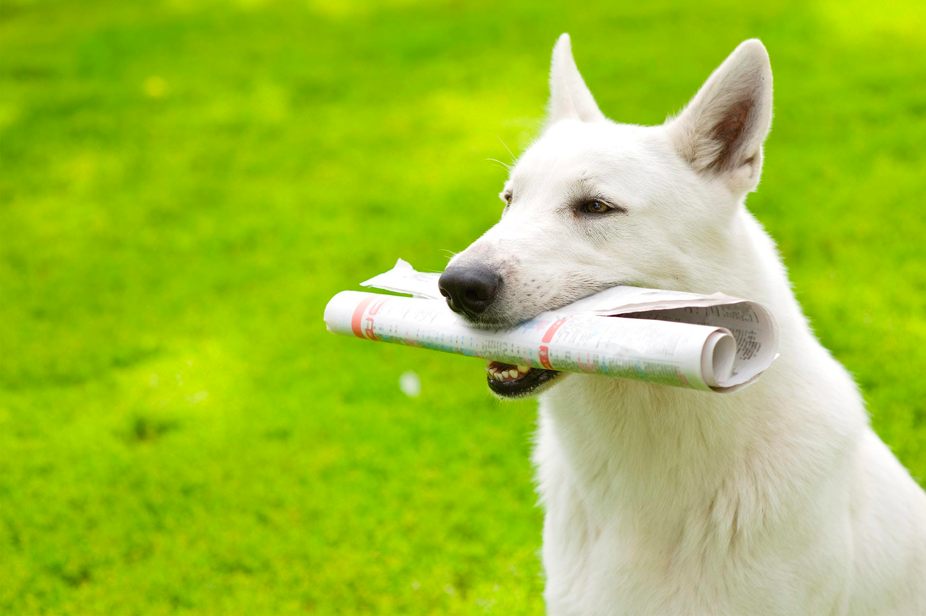
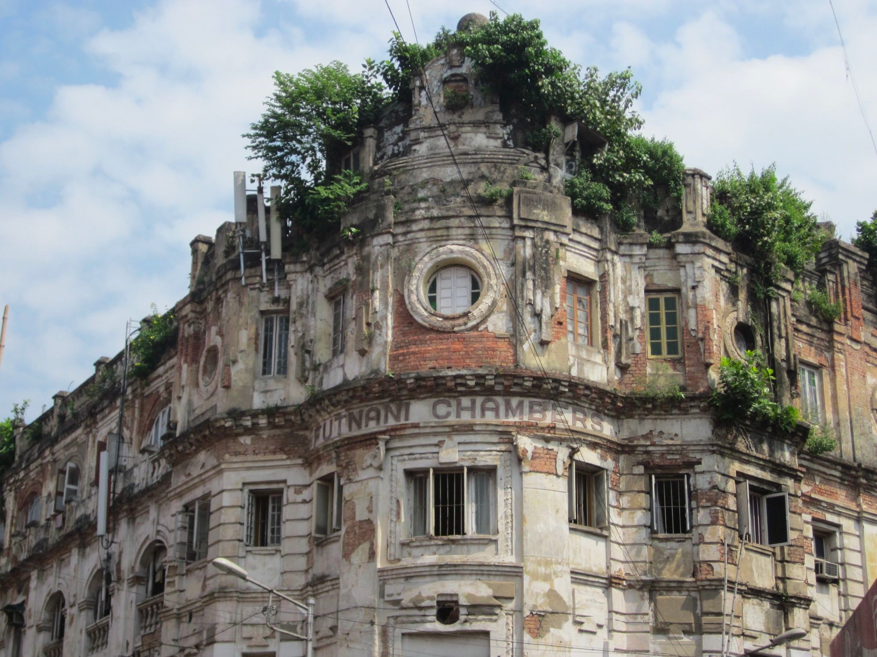
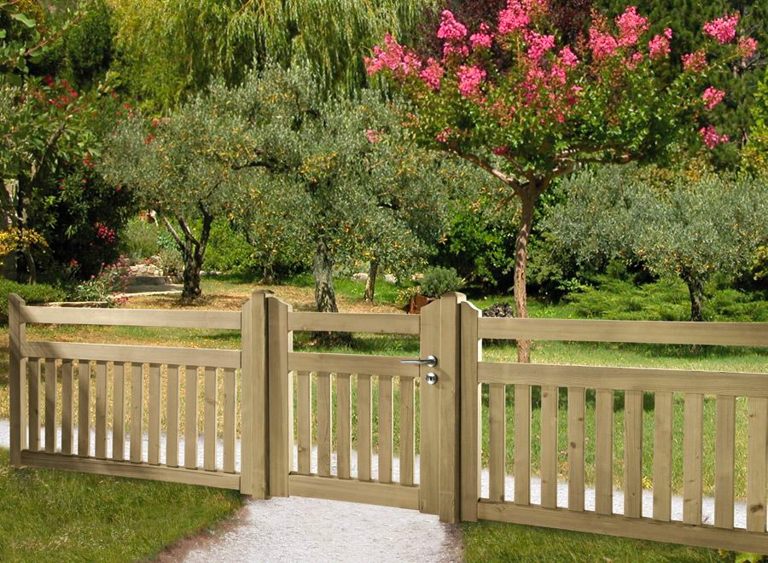
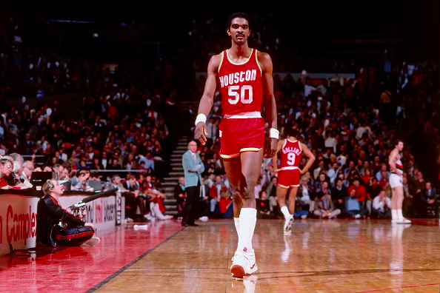
Definition
a smart dog
an old building
a low fence
a tall man
Definition: An adjective is a describing word.
It tells you more about a noun.

Slide 8
POSITION
Positions
Examples
Before a noun
She is an impatient person.
adj n
After a verb (to be)
Today is wonderful. V_{tobe} Adj
After a verb of sensation
The food smells great today.
V_{sensation} Adj
He
Notes:
Look, smell, taste, sound
Tiếp theo chúng mình sẽ đến với vị trí của tính từ
Mình sẽ có ví dụ sau đây: “She is an impatient person” (Cô ấy là một người ko kiên nhẫn)
Rồi, X nào, cho cô hỏi trong trường hợp này thì tính từ đang đứng trước hay đứng sau danh từ nhỉ? (ĐỨNG TRƯỚC DANH TỪ) → Good job
Tiếp theo chúng mình today is wonderful → Y nào, trong trường hợp này thì tính từ sẽ đứng như thế nào so với động từ to be nhỉ? (ĐỨNG SAU ĐỘNG TỪ TO BE), Yes → correct
Cuối cùng, mình sẽ có ví dụ “The food smells great today” → Z nào, em dịch cụm này như thế nào nhỉ? (HÔM NAY ĐỒ ĂN NGỬI MÙI RẤT THƠM)
Chính xác, vậy động từ SMELL này thì em thấy nó là động từ chỉ gì của con người nhỉ? (CHỈ GIÁC QUAN/khứu giác) → Yes, good job
Tính từ còn có thể đứng sau những động từ chỉ giác quan trong tiếng anh (FEEL - cảm thấy; LOOK - nhìn, trông có vẻ; SOUND/HEAR - nghe có vẻ)
I feel tired after studying all day/ She felt cold, so she put on a jacket.
You look beautiful in that dress
That idea sounds great / Her voice sounds sweet.

Slide 9
Exercise: Underline the adjectives
6
They are hardworking and never give up.
She is kind to everyone she meets, always trying to help other people.
He is friendly - always welcoming everyone with a smile.
She is a reliable person, so you can always count on her.
I find him very funny, because he tells great jokes.
1
She is generous and always helps other people.
He is cheerful - he makes me smile.
My brother is an honest person, so you can trust him.
She is very creative and loves making art.
He is patient with children.
2
7
3
8
4
9
5
10

Slide 10
Exercise: Underline the adjectives
6
They are hardworking and never give up.
She is kind to everyone she meets, always trying to help other people.
He is friendly - always welcoming everyone with a smile.
She is a reliable person, so you can always count on her.
I find him very funny, because he tells great jokes.
1
She is generous and always helps other people.
He is cheerful - he makes me smile.
My brother is an honest person, so you can trust him.
She is very creative and loves making art.
He is patient with children.
2
7
3
8
4
9
5
10

Slide 11
Ending letters (SUFFIX)
Suffix
Example
Suffix
Example
-able
-ous
-ent
-less
-ic
-y
-ed
-some
-like
drinkable
delicious
excellent
careless
artistic
tidy
interested
handsome
childlike
-ible
-ive
-ant
-ful
-ly
-al
-ing
-ish
...
possible
attractive
important
careful
lovely
professional
interesting
childish
...

Slide 12
Beginning letters (PREFIX)
Prefix
Example
Prefix
Example
un-
im-
il-
dis-
Incorrect
Irregular
non-academic
...
Unhappy
Impolite
Illegal
disloyal
in-
ir-
non-
...

Slide 13
Beginning letters (PREFIX)
Prefix
Example
Prefix
Example
Pre-
over-
…
Precooked
overcooked
…
bi-
co-
...
bilingual
codependent
...

Slide 14
Exercise: fill in the blanks with the correct prefix or suffix
I have a classmate named Mia. She is a very friend___ girl with a love___ smile. Her hair is long and a bit mess___, but it suits her. She is always help____ to others, and people really like her. Unlike some care_____ students, she is very organize___ and keeps her desk neat. Mia also has a beautiful face and a wonder____ personality. I don’t think she has any ____honest thoughts—she’s always honest and kind.

Slide 15
Exercise: fill in the blanks with the correct prefix or suffix
I have a classmate named Mia. She is a very friend___ girl with a love___ smile. Her hair is long and a bit mess___, but it suits her. She is always help____ to others, and people really like her. Unlike some care_____ students, she is very organize___ and keeps her desk neat. Mia also has a beautiful face and a wonder____ personality. I don’t think she has any ____honest thoughts—she’s always honest and kind.
ly
ly
y
ful
less
d
ful
dis

Slide 16
Types of adjectives
Quantitative
Descriptive
Demonstrative
Possessive
ADJECTIVE
Article
Distributive

Slide 17
Trật tự tính từ
Opinion | Size | Age | Shape | Color | Origin | Material | Purpose
Nice Ugly Cheap Expensive Good Bad Stupid Smart Amazing | Big Huge Small Large Narrow Tall Short Medium | New Old Second-hand Ancient | Square Round Triangular Rectangular Flat | Red Black White Yellow … | American English Spanish Japanese … | Leather (da) Cotton Silk (lụa) Wooden Plastic Metal (kim loại) Silver (bạc) Gold Paper | Shopping Sleeping Touring Racing
Notes:
https://www.baamboozle.com/game/13081

Slide 18
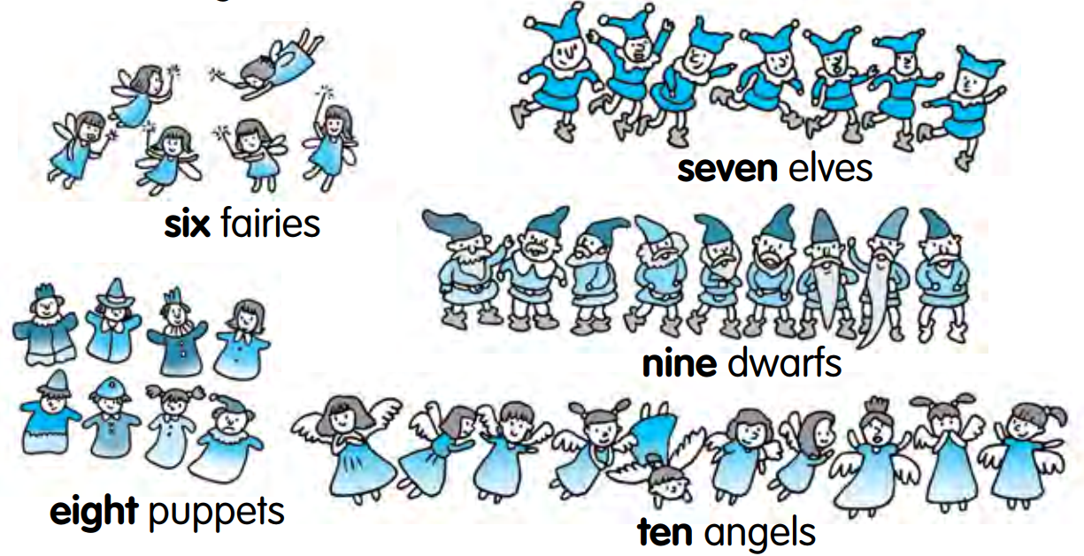
Quantity

Slide 19
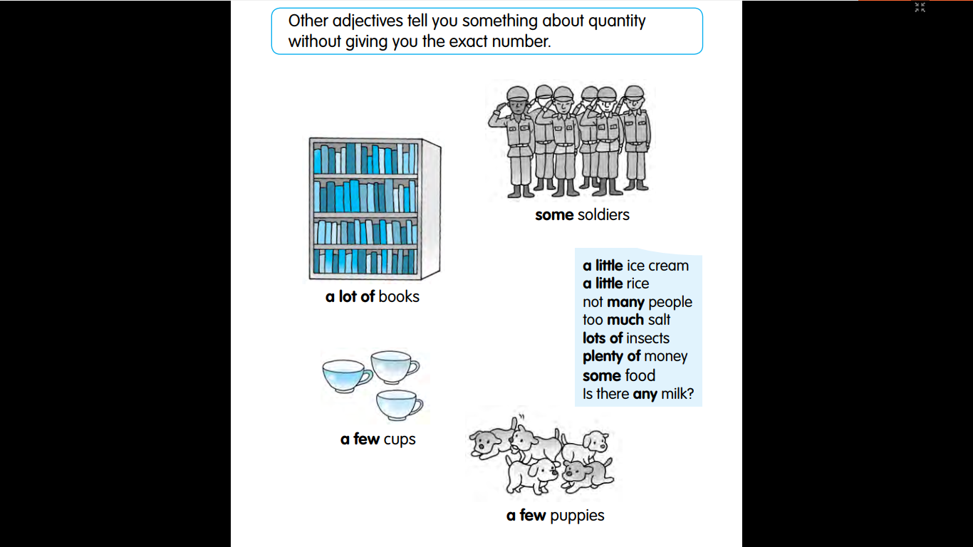
Quantity

Slide 20
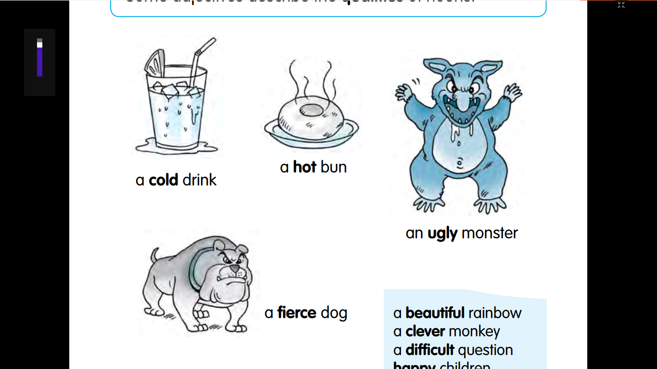
Qualities
(Opinion)

Slide 21
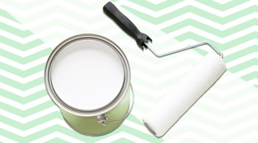


Color
white paint
blue sky
green leaf

Slide 22
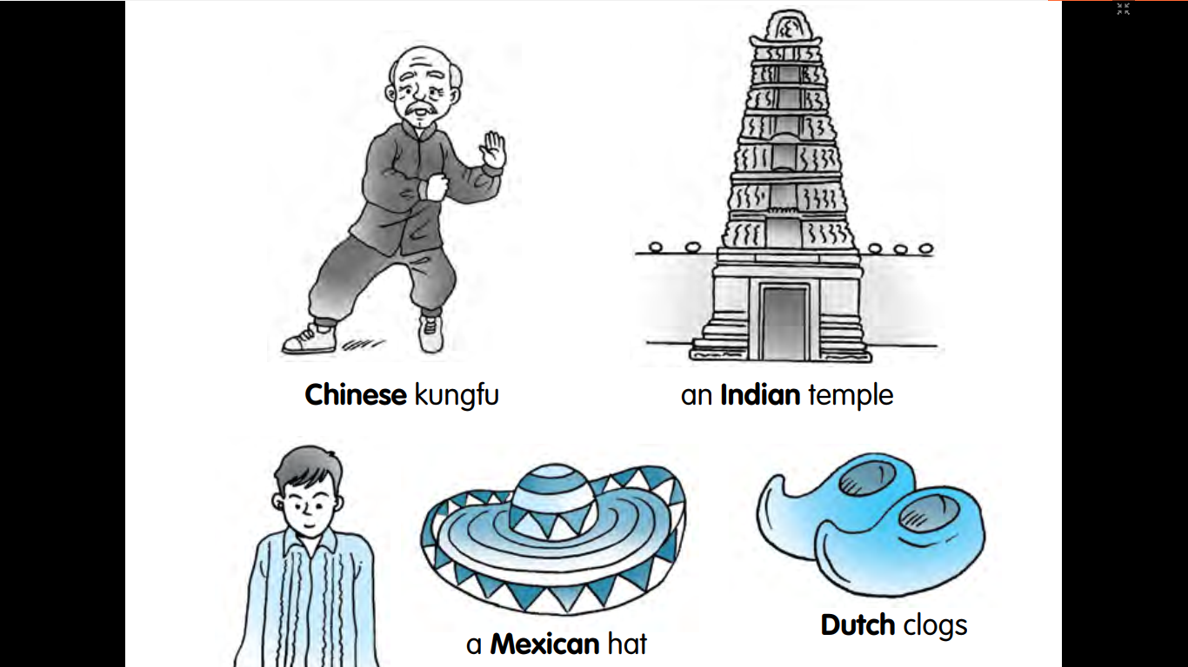
Origin

Slide 23
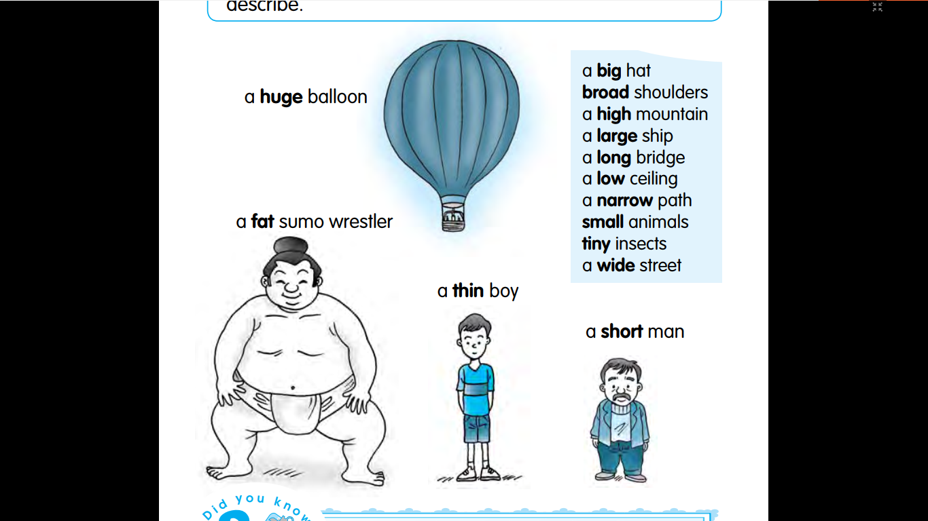

Size

Slide 24
Underline the adjectives and identify the type of each adjective:
My best friend is a tall girl with long black hair and a beautiful smile. She often wears a blue cotton dress that looks very nice on her. Last week, she bought a small golden necklace from a French shop. She also has a big brown bag where she keeps her books. Everyone likes her friendly face and young style.
Opinion | Size | Age | Shape | Color | Origin | Material | Purpose
Beautiful, nice, friendly | Tall, long, small, big | young |  | Black, blue, brown | French | Cotton, golden

Slide 25
SPEAKING QUESTIONS
What do you usually do with your friends?
What is your favourite subject at school?
Do you like travelling?
Do you like your school? Why?
Do you like watching movies?
What kind of clothes do you usually wear?

Slide 26
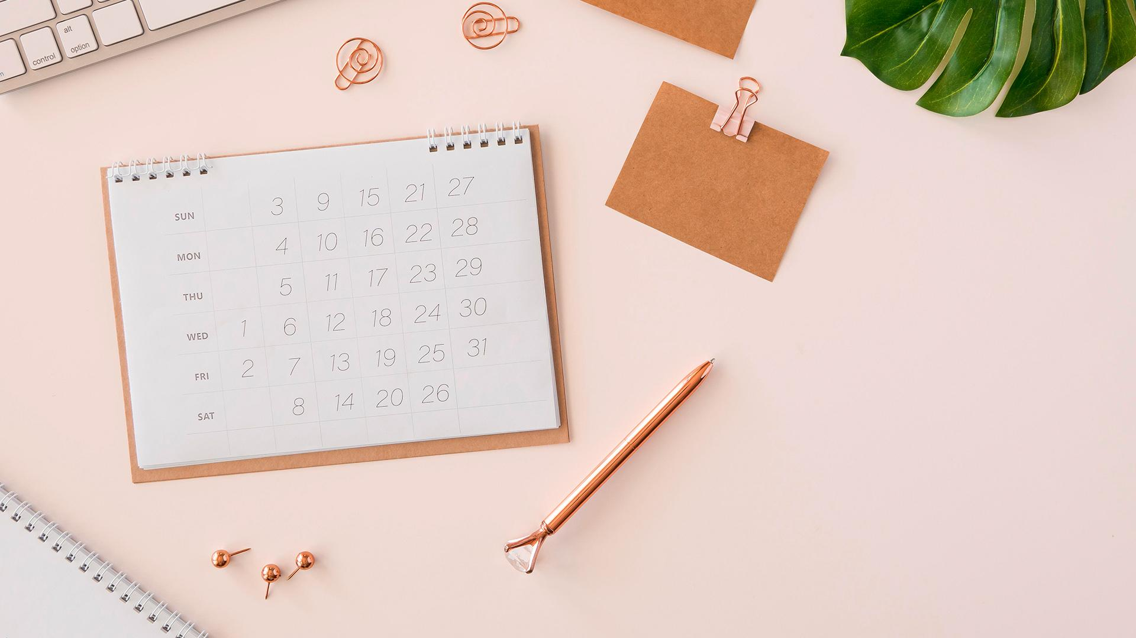

GOODBYE
See you later!

